Slide 1


Principles of Computing
Presentation by
Lyernisha S R

Slide 2
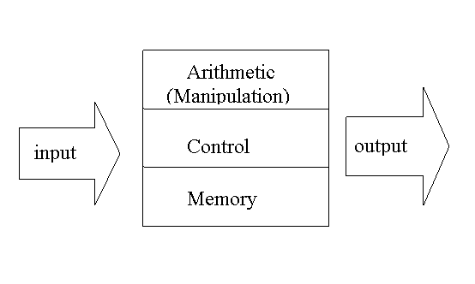
Computer
three components inside the black box

Slide 3
Automata Theory
Automata theory is a theoretical branch of computer science and mathematics
Automata Theory deals with the logic of computation with respect to simple machines referred to as automata
Automatons are abstract models of machines that perform computations on an input by moving through a series of states
At each state of the computation a transition function determines the next configuration based on a finite portion of the present configuration
As a result, once the computation reaches an accepting configuration, it accepts the input.
Through automata, Computer scientists can understand how machines compute functions and solve problems.

Slide 4
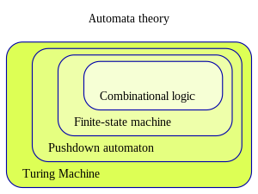

Slide 5
Strings and Languages

Slide 6
Strings
A string is a sequence of discrete symbols from a known finite alphabet
Finite alphabet = a set of symbols
Examples
abcdef
11011100101
ҖفقلΛφψωΫ√

Slide 7
Notation for Strings
if x = abcd (use x to stand for “abcd”)
and y = dba (use y to stand for “dba”)
x^{R} = dcba (reversing the symbols in x)
|x| = |abcd| = 4 (the number of symbols in x)
x.y = abcddba (the result of joining x and y,i.e. concatenation)
(x.y is normally written as xy)
x² = x.x = abcdabcd x³ = abcdabcdabcd
x¹ = abcd x⁰ = Λ
The Empty String – Λ (lambda) ⎢ Λ ⎢=0

Slide 8
Languages
A language is a set of strings
Examples:
{yes, no, come-here, sit, run, good-boy}-this is a finite language
{ a, aa, aaa, aaaa, …… }- this is an infinite language
{ } -this is an empty set or empty language(Ø)
{ Λ } – this is an empty string

Slide 9
Natural languages
English:
alphabet = { a,b,c, …,z, ., ;, !, :, etc }
String: a valid sequence of English symbols
= a valid English sentence
English Language =
a set of valid English sentences

Slide 10
Set operation in strings
A U B all strings in either A or B
the union of A and B
A ∩ B all strings in both A and B
the intersection of A and B
A.B every combination of one string from A followed by one from B
the product of A and B

Slide 11
Example
A = { a, b, c } B = { b, c, d }
What is:
A ∩ B =
A U B =
A.B =
|A| = |B| =
|A| x |B| = |A.B| =
{b,c}
{a,b,c,d}
{(a,b),(a,c),(a,d),(b,b),(b,c),(b,d),(c,b),(c,c),(c,d)}
3
3
9
9

Slide 12
The difference between two sets A and B:
A \ B = { x | x ∈ A and x ∉ B }
e.g. A = { a, b, c }, B = { b, c, d }
A \ B = { a }, B \ A = { d }
The complement of A
A’ = { x | x ∉ A } all strings not in A using the same alphabet as A
Let U denote ‘the universe’, i.e. all possible string using same alphabet as A, then the complement of A can be also expressed as
A’ = U \ A

Slide 13
Examples
A = {Λ , a, aa, aaa } ( alphabet = {a} )
The universe set = {Λ , a, aa, aaa , aaaa, … }
= { a^{n} | n >= 0 }
A’ = {aaaa, aaaaa, aaaaaa, … }
= { a^{n} | n > 3 }

Slide 14
Venn Diagrams – illustrating the set operations:

Slide 15
1. Union
a b c
B =
c d e
A =
a b c d e
A U B =
= { a, b, c, d, e}

Slide 16
2. Intersection
a b c
B =
c d e
A =
a b c d e
A ∩ B =
= { c }

Slide 17
3. Difference
a b c
B =
c d e
A =
a b c d e
A \ B =
= { a, b }
B \ A =
a b c d e
= { d, e }

Slide 18
4. Complement
Universe
U =
Λ
a b c aa ab ac ba bb bc ca cb cc
aaa aab aac baa
bab bac bba bbb
bbc caa cab cac
cba cbb cbc cca
ccb ccc aaaa ...
......
A =
a b c
Λ
aa ab ac ba bb bc ca cb cc
aaa aab aac baa
bab bac bba bbb
bbc caa cab cac
cba cbb cbc cca
ccb ccc aaaa
......
a b c
A’ = U \ A =

Slide 19
Closure
A⁰ = { Λ }, A¹ = A, A² = A.A etc
A* = A⁰ U A¹ U A² U …… (Kleene star of A )
(the closure of A)
A⁺ = A¹ U A² U A³ U …… (the +ve closure of A)

Slide 20
Examples
A = { a },
What is:
A* = {Λ,a,aa,aaa,aaaa,……..} ={a^{n} | n≥0 }
A⁺ ={a,aa,aaa,aaaa,aaaaa,.....} ={a^{n} | n≥1 }

Slide 21
Examples
A = { a, b }, B = { Λ, a, b }
What is:
A* =
B* =
A⁺ =
B⁺ =
{Λ,a,b,aa,ab,ba,bb,aaa,aab,aba,….}
{Λ,a,b,aa,ab,ba,bb,aaa,aab,aba,….}
{a,b,aa,ab,ba,bb,aaa,aab,aba,….}
{a,b,aa,ab,ba,bb,aaa,aab,aba,….}

Slide 22
Thank you!

